Slide 1
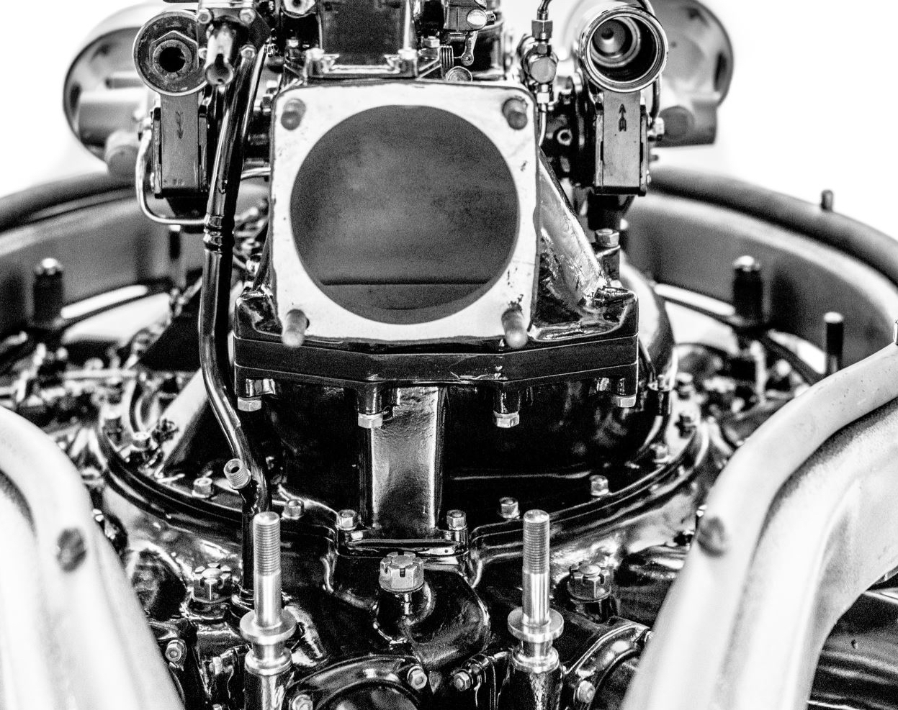

Miniature Scaled Working Engine Models
Edutek Equipments India Pvt. Ltd., Delhi
Edu-Tek Equipments India Private Limited - 2024 - All Rights Reserved

Slide 2
Table of Contents
1/2
1. About Us
2. Key Value Adders
3. Aerial Engines
  Turbo Fan Engine-Electrically Operated
  Jet Engine with Panel Opening (Similar to Aircrafts)-Electrically Operated
  Turbo Jet Engine-Electrically Operated
  Radial Engine-Electrically Operated
4. Internal Combustion Engines
  Single Cylinder 4 Stroke Air Cooled Vertical-Fuel Operated (Gasoline)
  Single Cylinder 4 Stroke Water Cooled Vertical-Fuel Operated (Gasoline)
  Single Cylinder 4 Stroke Horizontal Engine-Manual (Mimicking Gasoline)
  Single Cylinder 4 Stroke-Electrically Operated (Mimicking Diesel)
  Single Cylinder 2 Stroke-Fuel Operated (Gasoline)
  Single Cylinder 3 Stroke-Fuel Operated (Gasoline)
  Multi Cylinder 4 Stroke Basic-Electrically Operated (Mimicking Gasoline)
  Multi Cylinder 4 Stroke Highly detailed-Electrically Operated (Mimicking Gasoline)
  Multi Cylinder 4 Stroke T, & V shaped engines-Fuel Operated (V2, V4, V8 also available) (Gasoline)
  Multi Cylinder 4 Stroke-Electrically Operated (Mimicking Diesel)
  Rotary/Wankel Engine-Electrically Operated
Edu-Tek Equipments India Private Limited - 2024 - All Rights Reserved

Slide 3
Table of Contents
2/2
5. Steam Engines
  Steam Engine with Boiler-Fuel Operated
  Vertical Steam Engine with Cylindrical Boiler-Fuel Operated
  Vertical Steam engine with Spherical Boiler-Fuel Operated
  Multistage Steam Turbine Model-Air Operated
  Fuel Based Jet Engine Model
6. Others
  Solenoid based V8 engine ( V2, V4, V6, V12 Variants also available)-Electrically Operated
  Oil Rig (15+ Variants available)-Fuel Operated
  Sterling Engine (50+ Variants available)-Fuel Operated
  Car Gear Mechanism Model
  Hydraulic Press Lab Model
7. List of Other available engines and products
8. Sales Information
Edu-Tek Equipments India Private Limited - 2024 - All Rights Reserved

Slide 4
About Us
Edutek Equipments India Pvt. Ltd. has been dedicated to building and supplying training and research equipment to leading engineering and research institutes worldwide. To date, we have supplied, installed, and commissioned over 100 engine test rigs to prestigious institutions such as NITs, IITs, IISCs, and other state and government engineering colleges.
With over 30 years of industry experience, we have gained a deep understanding of the specific needs of these institutions. They require robust, easy-to-operate, quality and cost-effective equipment that not only educates students on the intricacies of machinery but also demonstrates how various components work together to operate equipment effectively.
With this clarity of purpose, we are excited to launch a new range of working scaled models of various types of engines including Aero-engines, Automotive engines, Steam engines and those engines which are not used but are essential part of teaching curriculum such as Wankel engine, Stirling Engine etc.
In this presentation, we will showcase the specifications and working videos of some of our products. At the end of the presentation, you will find a comprehensive list of products that can be ordered and made available for teaching in almost no time.
Edu-Tek Equipments India Private Limited - 2024 - All Rights Reserved

Slide 5
Key Value Adders
Scaled Models of Real Working Engines: Being scaled models of actual working engines, these models are large enough to display all the working parts of the engine, providing a comprehensive learning experience. Please refer to videos attached on slides: 8, 10, 12, 14, 17, 19, 21, 25, 27, 29, 33, 35, 37, 39, 41, 43, 45, 48, 50, & 52 for a better view of these models.
Superior to Traditional Cut-Section Models: Our models offer a more detailed and accurate representation compared to standard cut-section models.
High Quality with Great Attention to Detail: All parts closely mimic those in real engines, allowing students to observe details that are difficult to grasp through textbooks or online videos.
Flexibility: Equipment can be provided in both Completely Knocked Down (CKD) and assembled forms. CKD equipment can be assembled by students themselves, enabling them to understand the intricate details involved in building equipment and gain practical knowledge of how to assemble different parts and run the engines with actual fuel / electrical supply.
Zero Installation Time: These working models require no installation time, making it ready to use immediately upon arrival.
Cost-Effective: These working models are low-cost and can be purchased without the need for a tendering process.
Easily Transportable: All the models are light-weight and can easily be carried in the classroom for teaching purposes.
Edu-Tek Equipments India Private Limited - 2024 - All Rights Reserved

Slide 6
Aerial Engines
Turbo Fan Engine Electrically Operated
Aircraft Jet Engine With Opening Panel Electrically Operated
Turbo Jet Engine Electrically Operated
Radial Engine
Fuel Based Jet Engine Model
Edu-Tek Equipments India Private Limited - 2024 - All Rights Reserved

Slide 7
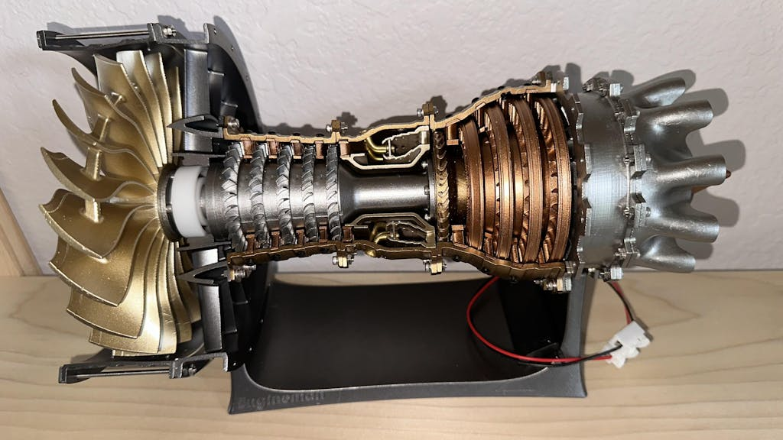
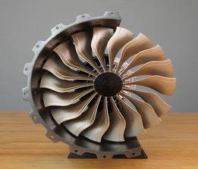
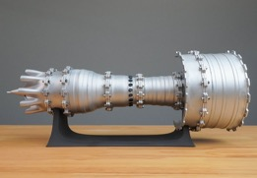
Aerial Engines
  Working Scaled Model: Turbo fan Engine
Specifications
Material: Resin Plastic
Model: TR900 Aircraft Turbofan Engine Model
Scale: 1/20
Product Dimensions:
34 x 15 x 18cm
Product Weight: 1000g
Package Dimensions:
30 x 30 x 10cm
Package Weight: 1200g
Electrically Operated
Edu-Tek Equipments India Private Limited - 2024 - All Rights Reserved

Slide 8
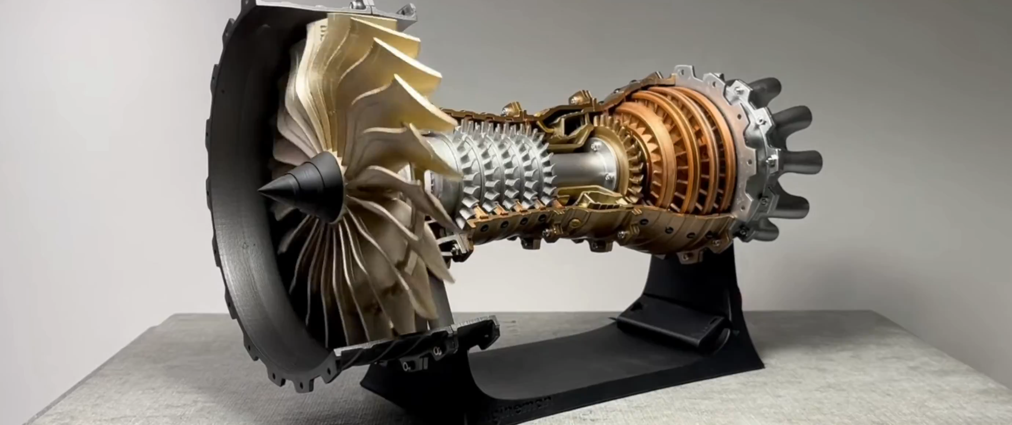
Aerial Engines
  Working Scaled Model: Turbo fan Engine
Edu-Tek Equipments India Private Limited - 2024 - All Rights Reserved

Slide 9
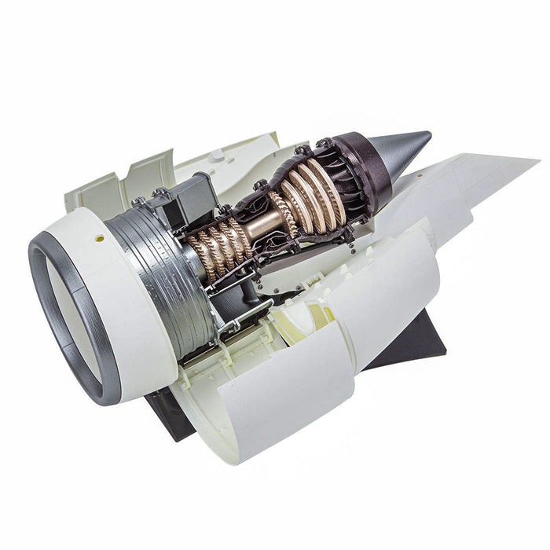
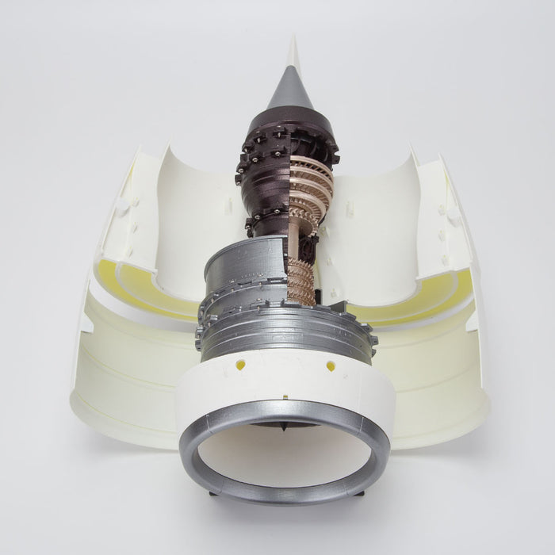
Aerial Engines
  Working Scaled Model: Jet Engine
Specifications
Scale: 1:30
Product size: 36*13*15cm
Packing size: 30*30*10cm
Product material: ABS heat-resistant and corrosion-resistant plastic
Product weight: 1300g
Part quantity: 150+PCS
Motor voltage: 12V DC voltage
Electrically Operated
Edu-Tek Equipments India Private Limited - 2024 - All Rights Reserved

Slide 10
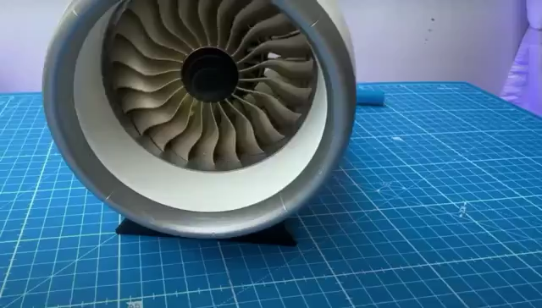
Aerial Engines
  Working Scaled Model: Jet Engine
Edu-Tek Equipments India Private Limited - 2024 - All Rights Reserved

Slide 11
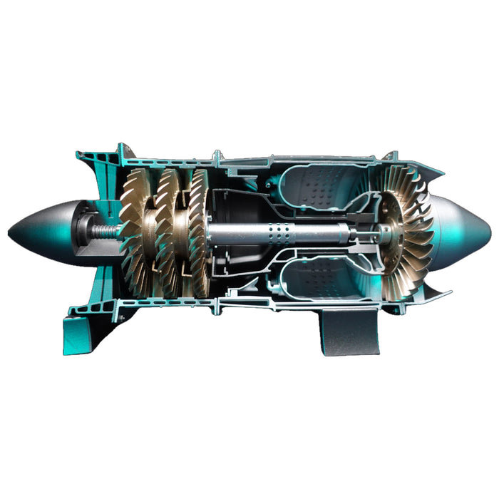
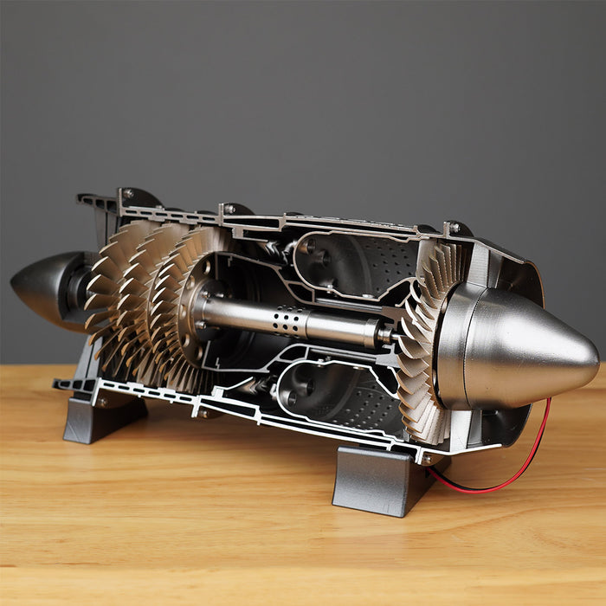
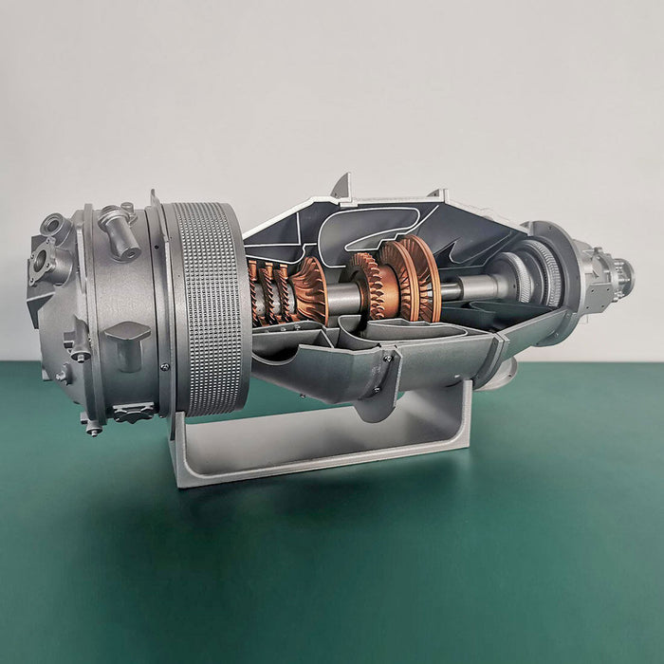
Aerial Engines
  Working Scaled Model: Turbo Jet Engine
Specifications
Material: Resin Plastic
Model: WP-85 Turbojet Engine
Scale: 1/3
Motor Voltage: 12V DC Voltage
Product Size: 36*12*14cm
Product Weight: 800g
Packing Size: 32*30*10cm
Package Weight: 1000g
Packing: Box
Electrically Operated
Edu-Tek Equipments India Private Limited - 2024 - All Rights Reserved

Slide 12
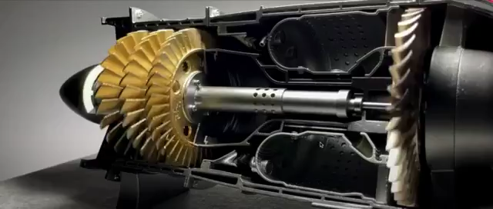
Aerial Engines
  Working Scaled Model: Turbo Jet Engine
Edu-Tek Equipments India Private Limited - 2024 - All Rights Reserved

Slide 13
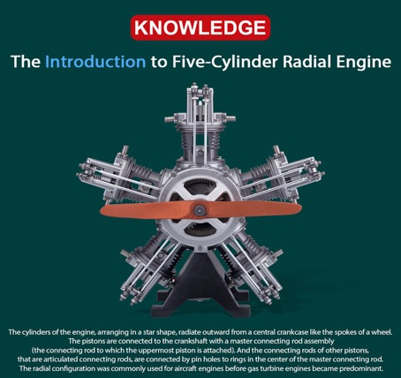
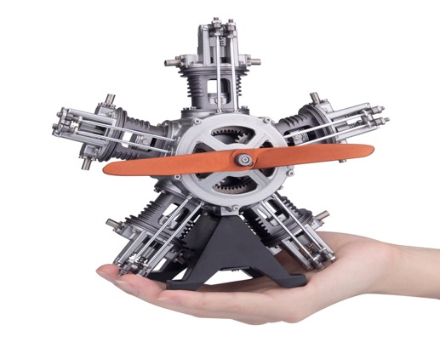
Aerial Engines
  Working Scaled Model: Radial Engine
Specifications
Product name: Five-cylinder radial engine
Scale: 1/6
Charging voltage: DC 5V
Charging time: 2 hours
Function: Automatic power off when encountering external resistance
Material: aluminum alloy + stainless steel
Product Weight: 1900g
Package Dimensions: 34 x 24 x 14.5cm
Package Weight: 2500g
Electrically Operated
Edu-Tek Equipments India Private Limited - 2024 - All Rights Reserved

Slide 14
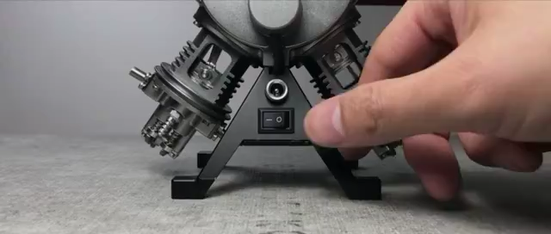
Aerial Engines
  Working Scaled Model: Radial Engine
Edu-Tek Equipments India Private Limited - 2024 - All Rights Reserved

Slide 15
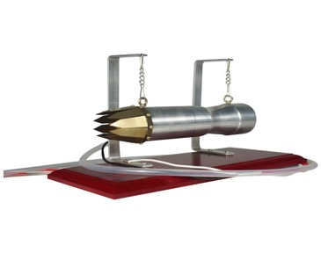
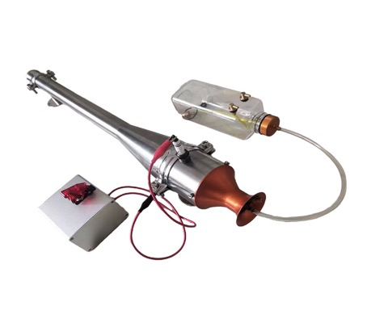
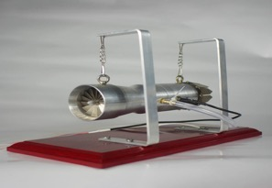
Aerial Engines
  Working Scaled Model: Jet Engine
Specifications
Material: Alloy + Electronic Components
Speed: 1000-2000RPM
Product Dimensions: 24 x 12.5 x 18cm
Product Weight: 2000g
Package Dimensions: 28 x 20 x 15cm
Package Weight: 2300g
Packing: Box
Fuel Operated
Edu-Tek Equipments India Private Limited - 2024 - All Rights Reserved

Slide 16
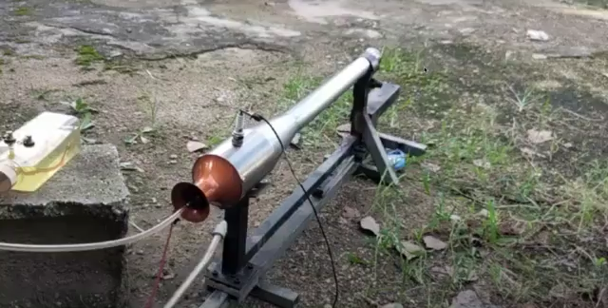
Aerial Engines
  Working Scaled Model: Jet Engine
Edu-Tek Equipments India Private Limited - 2024 - All Rights Reserved

Slide 17
Internal Combustion Engines
Single Cylinder Petrol (4 Stroke)
Single Cylinder 4 Stroke Air Cooled Vertical-Fuel (Gasoline)
Single Cylinder 4 Stroke -Electricity based (Mimicking Diesel)
Single Cylinder 2 Stroke -Fuel (Gasoline)
Single Cylinder 3 Stroke-Fuel (Gasoline)
Multi Cylinder (Gasoline)
Multi Cylinder 4 Stroke Basic-Electricity based (Mimicking Gasoline)
Multi Cylinder 4 Stroke Highly detailed-Electricity based (Mimicking Gasoline)
Multi Cylinder 4 Stroke T , & V shaped engines-Fuel (V2, V4, V8 also available) (Gasoline)
Multi Cylinder 4 Stroke–Electricity based (Mimicking Diesel)
Single Cylinder 4 Stroke Water Cooled Vertical-Fuel (Gasoline)
Single Cylinder 4 Stroke Horizontal Engine-Manual (Mimicking Gasoline)
Edu-Tek Equipments India Private Limited - 2024 - All Rights Reserved

Slide 18
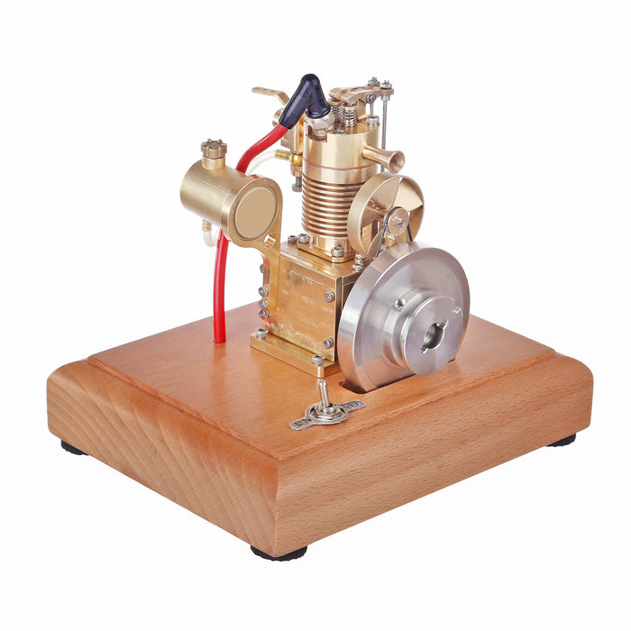
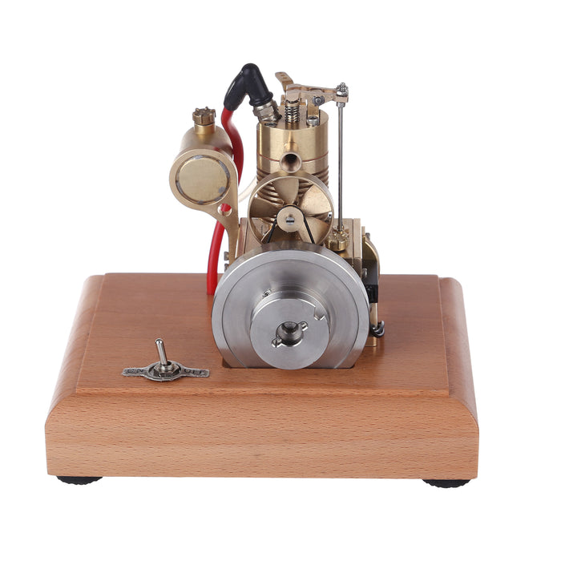
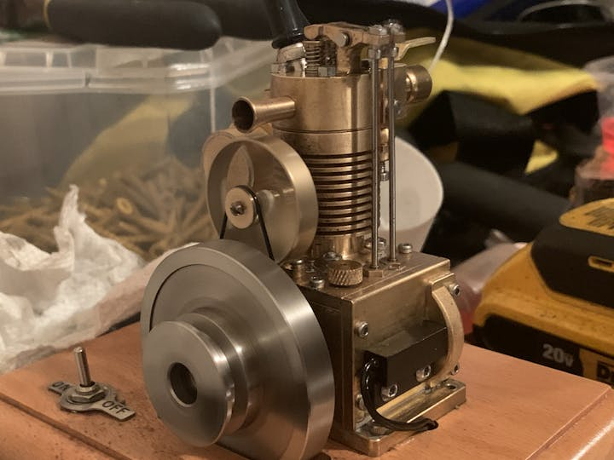
Internal Combustion Engines
  Working Scaled Model: Single Cylinder 4 Stroke Air Cooled Vertical-Fuel (Gasoline)
Specifications
Material: Brass + Stainless Steel + Wood
Displacement: 1.6cc
Cylinder Diameter: 13mm
Flywheel Diameter: 56mm
Tank Capacity: 8ML
Power Supply Voltage of Ignition Device: 4.5V(Powered by 3 AA batteries but not included)
Start Mode: External Force (Electric Drill) or Hand Pull Start
Fuel Used: Gasoline or Aviation Kerosene
Overall Size: 150 x 120 x 130mm
Base Size: 150 x 120 x 30mm
Engine Size: 8 x 7 x 10cm
Product Weight: 980g
Package Dimensions: 20 x 20 x 15cm
Package Weight: 1500g
Fuel Operated
Edu-Tek Equipments India Private Limited - 2024 - All Rights Reserved

Slide 19
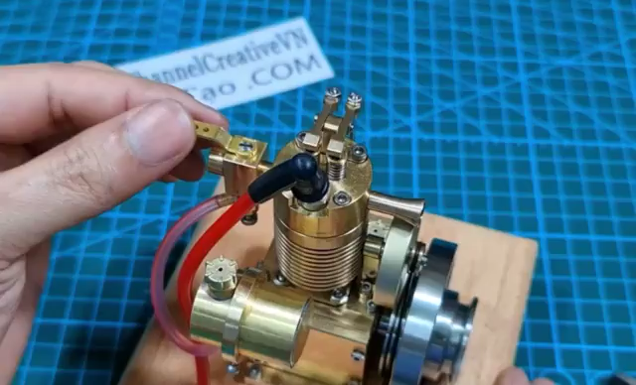
Internal Combustion Engines
  Working Scaled Model: Single Cylinder 4 Stroke Air Cooled Vertical-Fuel (Gasoline)
Edu-Tek Equipments India Private Limited - 2024 - All Rights Reserved

Slide 20
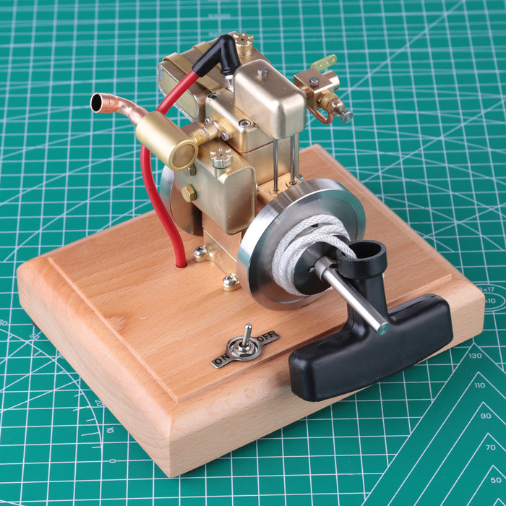
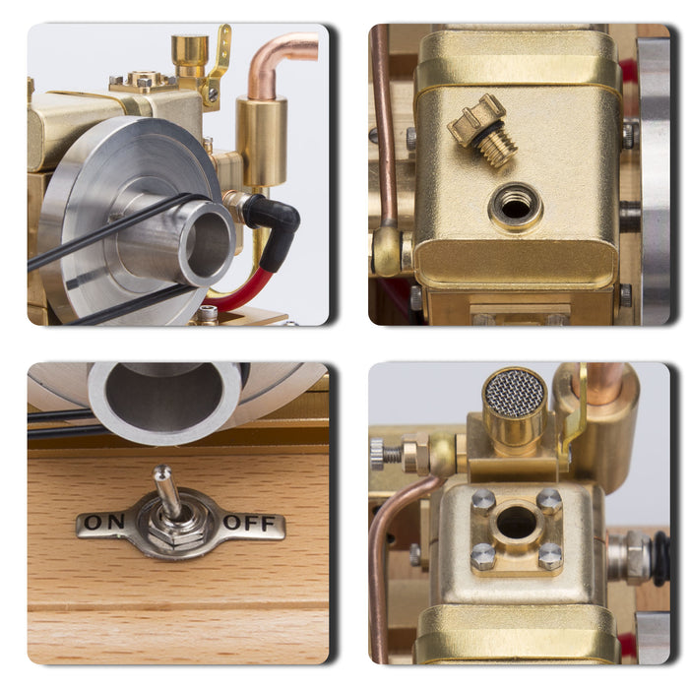
Internal Combustion Engines
  Working Scaled Model: Single Cylinder 4 Stroke Water Cooled Vertical-Fuel (Gasoline)
Specifications
Material: Brass + Stainless Steel + Wood
Powered By: The ignition is powered by 1.5V power supply.
Carburetor : Adjustable
Displacement: 1.6CC
Cylinder Diameter: 13mm
Stroke: 12mm
Wooden Base: 150 x 120 x 30mm
Engine: 104 x 94 x 78mm
Product Size: 15 x 12 x 10.8cm
Product Weight: 1400g
Package Dimensions: 20 x 20 x 15cm
Fuel Operated
Edu-Tek Equipments India Private Limited - 2024 - All Rights Reserved

Slide 21
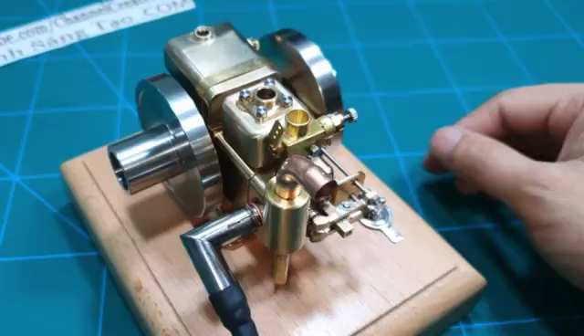
Internal Combustion Engines
  Working Scaled Model: Single Cylinder 4 Stroke Water Cooled Vertical-Fuel (Gasoline)
Edu-Tek Equipments India Private Limited - 2024 - All Rights Reserved

Slide 22
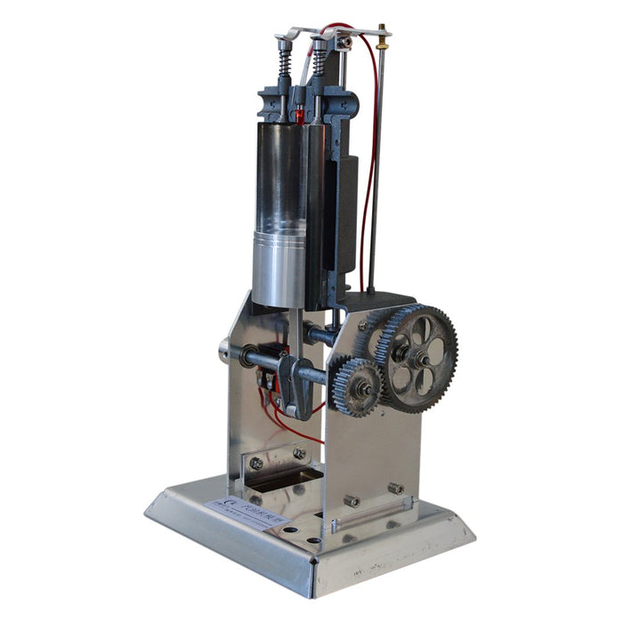
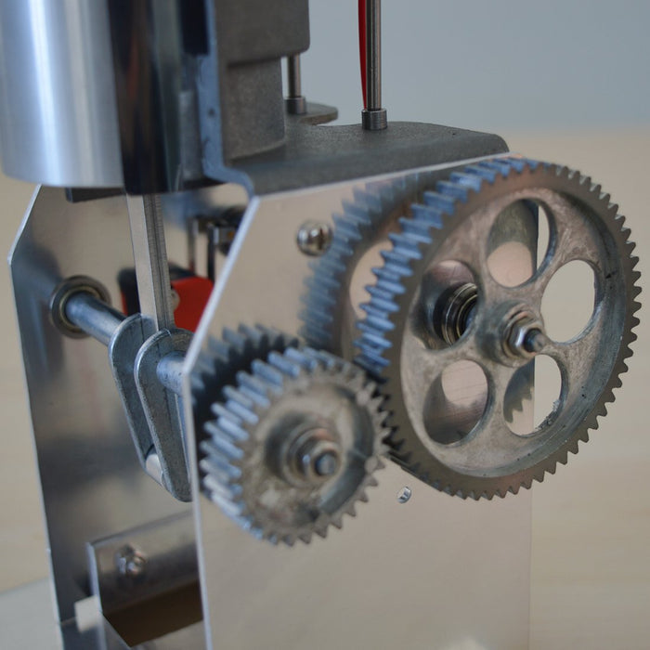
Internal Combustion Engines
  Working Scaled Model: Single Cylinder 4 Stroke Engine-Manual (Mimicking Gasoline)
Specifications
Material: Metal
Product Weight: 1300g
Package Dimensions: 16*13*29cm
Package Weight: 1400g
Manually operated
Edu-Tek Equipments India Private Limited - 2024 - All Rights Reserved

Slide 23
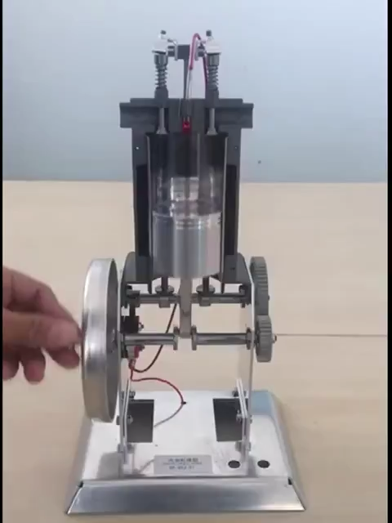
Internal Combustion Engines
  Working Scaled Model: Single Cylinder 4 Stroke Horizontal Engine-Manual (Mimicking Gasoline)
Edu-Tek Equipments India Private Limited - 2024 - All Rights Reserved

Slide 24
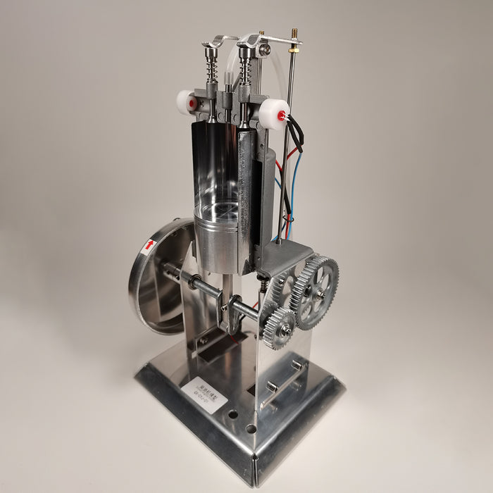
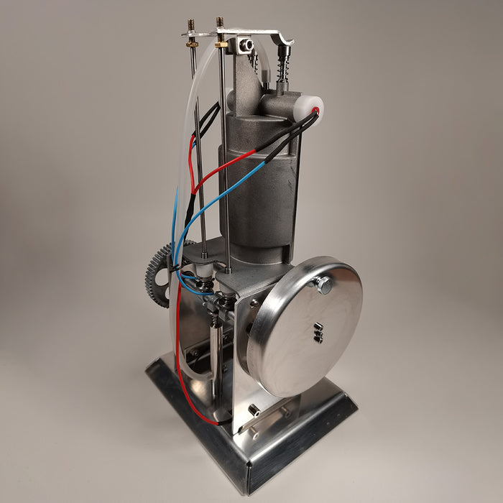
Internal Combustion Engines
  Working Scaled Model: Single Cylinder 4 Stroke –Electrically operated (Mimicking Diesel)
Specifications
Material: Metal
Product Weight: 1000g
Product Dimensions: 16 x 12 x 30cm
Package Dimensions: 19 x 15.2 x 33cm
Package Weight: 1400g
Electrically Operated
Edu-Tek Equipments India Private Limited - 2024 - All Rights Reserved

Slide 25
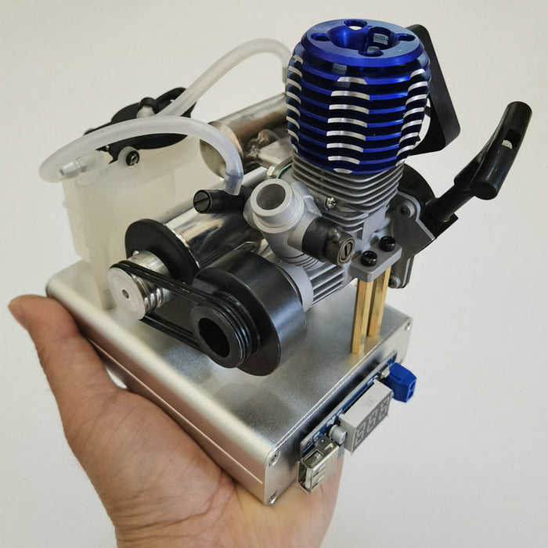
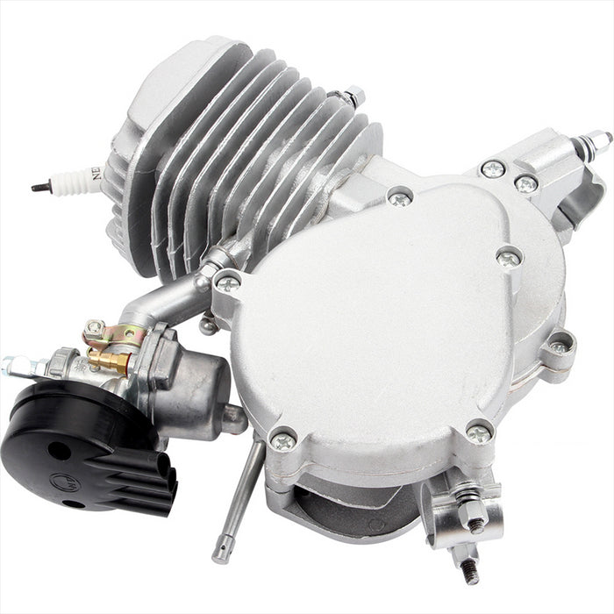
Internal Combustion Engines
  Working Scaled Model: Single Cylinder 2 Stroke -Fuel (Gasoline)
Specifications
Material: metal
Color: silver;
Engine size: 260*240*200mm;
Weight: 4700g;
Type: Single Cylinder two-stroke gasoline engine;
Displacement: 80cc;
Cylinder diameter: 87mm;
Stroke: 38mm;
Spark plug model: Z4C Fuel: 90#.
Cooling method: air-cooled;
Starting method: recoil hand-pull starter start;
Lubrication method: fuel mixture ratio new 16:1 (20:1 after 500 kilometers)
Fuel type: 92# and above gasoline;
Oil type: 2T motor oil
Also available in 49 and 47 CC
Fuel Operated
Edu-Tek Equipments India Private Limited - 2024 - All Rights Reserved

Slide 26
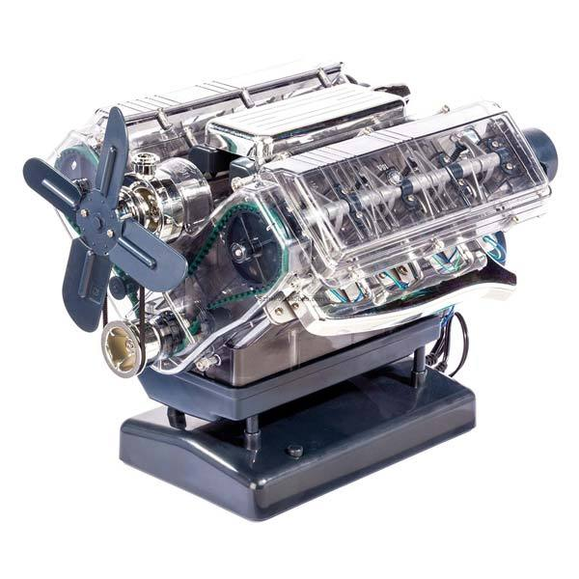
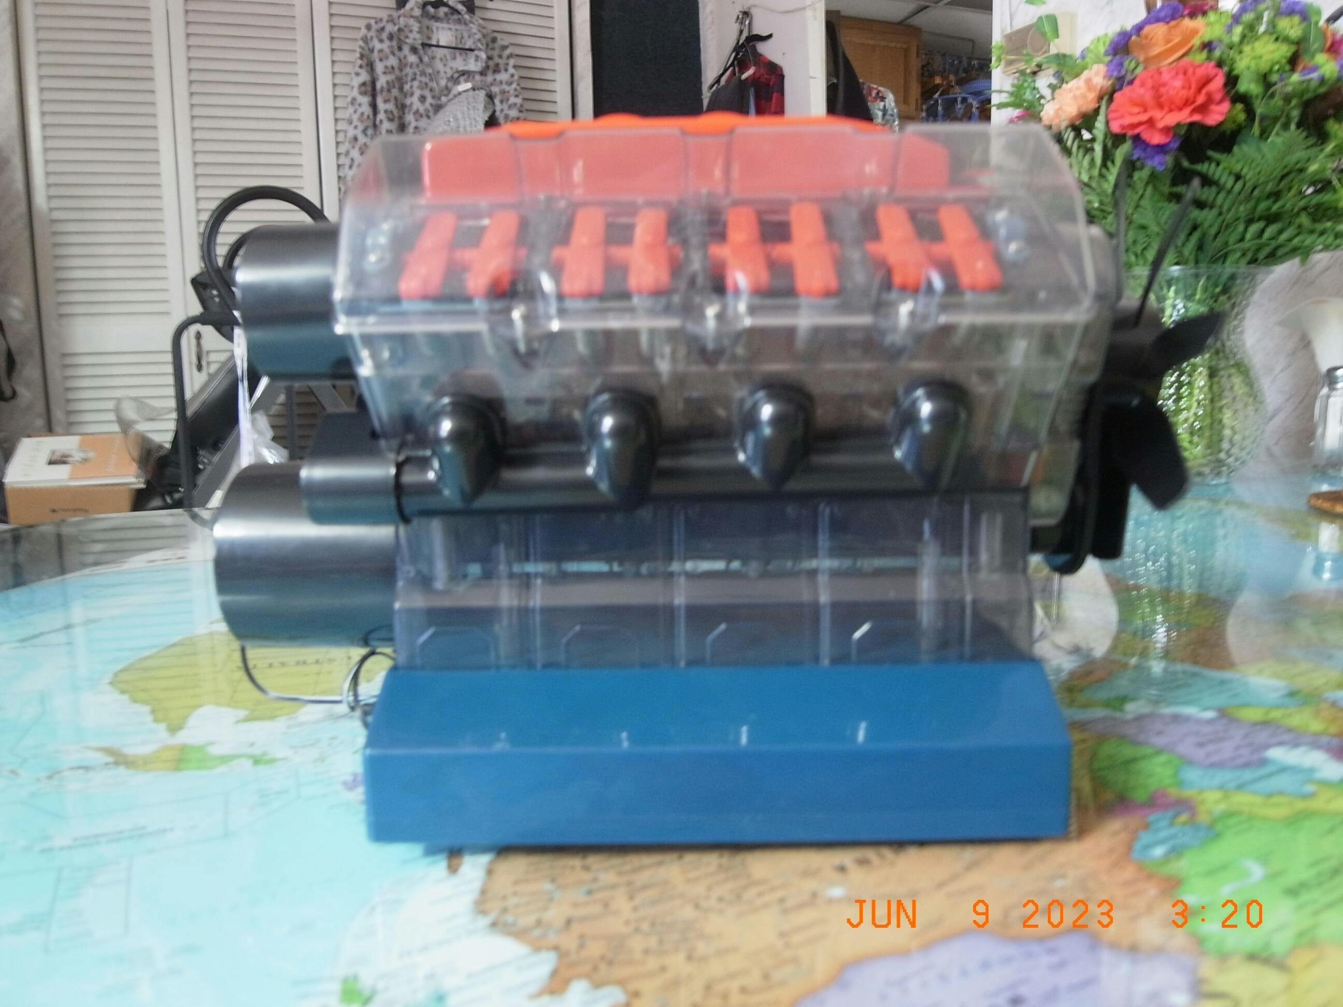
Internal Combustion Engines
  Working Scaled Model: Multi Cylinder 4 Stroke Basic-Electrically operated (Mimicking Gasoline)
Specifications
Item Name: V8 Engine Model Kit
Material: Metal + Plastic
Parts: 270pcs
Product Weight: 1790g
Package Dimensions: 50.4 x 35.5 x 10cm
Package Weight: 1900g
Packing: Box
Electrically and Manually Operated
Edu-Tek Equipments India Private Limited - 2024 - All Rights Reserved

Slide 27
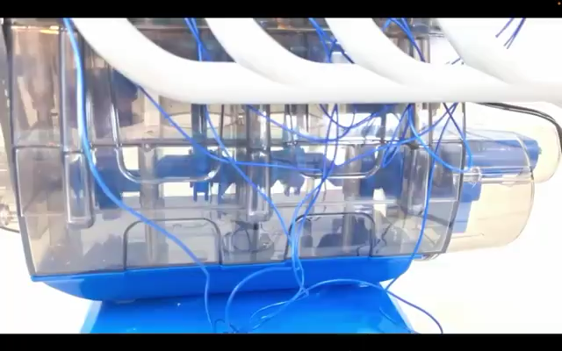
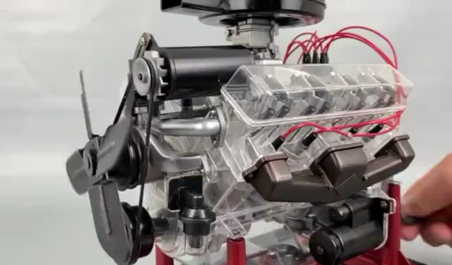
Internal Combustion Engines
  Working Scaled Model: Multi Cylinder 4 Stroke Basic-Electrically operated (Mimicking Gasoline)
Electric
Manual
Edu-Tek Equipments India Private Limited - 2024 - All Rights Reserved

Slide 28
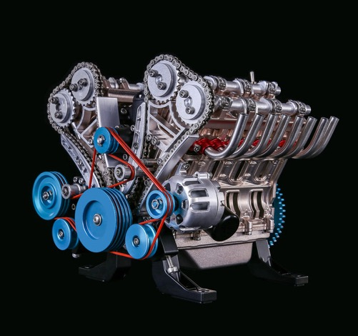
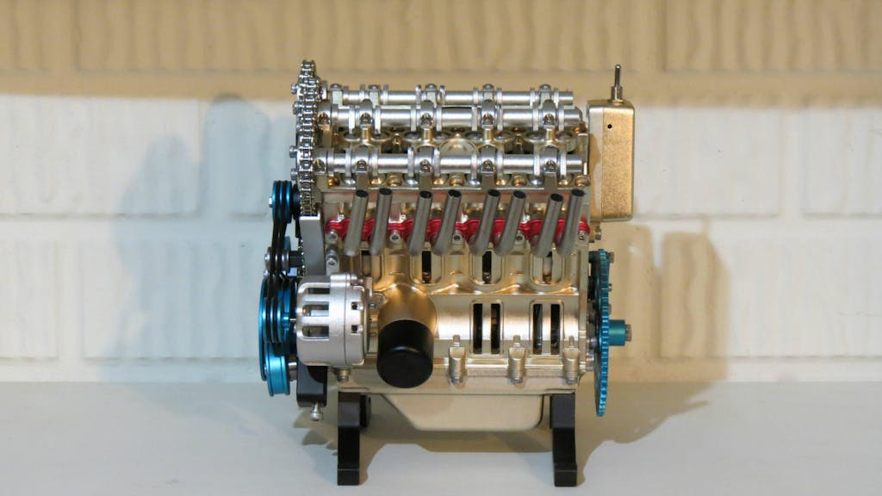
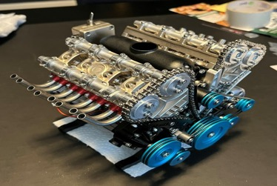
Internal Combustion Engines
  Working Scaled Model: Multi Cylinder 4 Stroke Highly detailed-Electricity based (Mimicking Gasoline)
Specifications
Material: Aluminum Alloy + Stainless Steel
Lithium Battery: 3.7V 500mAh
Charging Voltage: DC 5V
Charging Time: 2 hours
Usage Time: 1 hour
Product Dimensions: 17.2 x 19.8 x 18cm
Product Weight: 2550g
Package Dimensions: 34.2 x 24.2 x 15cm
Package Weight: 4500g
Packing: High-end Metal Gift Box
Electrically Operated
Edu-Tek Equipments India Private Limited - 2024 - All Rights Reserved

Slide 29
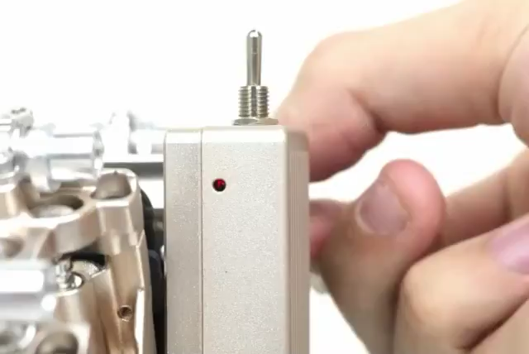
Internal Combustion Engines
  Working Scaled Model: Multi Cylinder 4 Stroke Highly detailed-Electrically operated (Mimicking Gasoline)
Edu-Tek Equipments India Private Limited - 2024 - All Rights Reserved

Slide 30
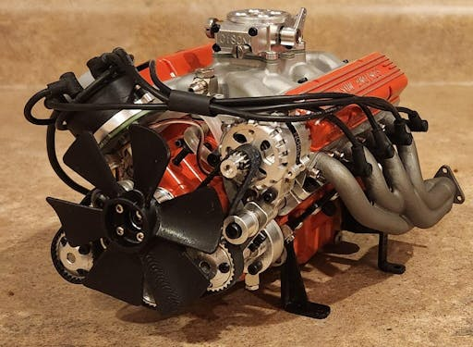
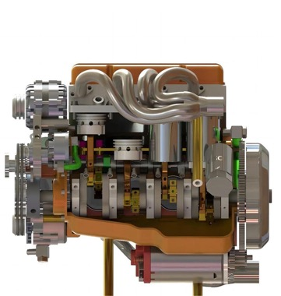
Internal Combustion Engines
1/6
  Working Scaled Model: Multi Cylinder 4 Stroke T, & V shaped engines-Fuel (V2, V4, V8 also available) (Gasoline)
Specifications
Material: Metal
Engine Type: Gasoline Internal Combustion
Valve Mechanism Type: OHV/Flathead
Displacement: 44CC (8*5.5CC)
Cylinders: V8
Stroke: 4-Stroke; Bore Diameter: 18.5mm
Stroke Length: 20.5mm
RPM Range: 1500-10000rpm(OHV) 1500-7500rpm(Flathead)
Power: Approx. 4.8hp(OHV) 3.3hp(Flathead)
Cooling Method: Water-Cooled
Lubrication Method: Independent Lubrication System
Start Method: Electric Start
Ignition Method: Distributor Ignition (High-Performance CDI Ignition, Frequency 42000)
Spark Plug Type: 1/4-32 ME8 Type Spark Plug
Starting Power Source: 6-12V (Recommended 2S-3S Lipo Battery)
Fuel Type: Gasoline (Recommended 92# and Above Gasoline)
Lubricating Oil Type: 2T Engine Oil (Recommended 10W50 2T Engine Oil)
Product Weight: 1700g
Product Dimensions: 14 x 9.3 x 10cm
Package Dimensions: 30 x 20 x 20cm
Package Weight: 2500g
Fuel Operated
Edu-Tek Equipments India Private Limited - 2024 - All Rights Reserved

Slide 31
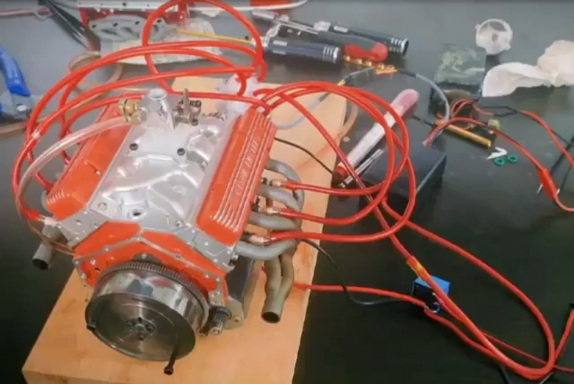
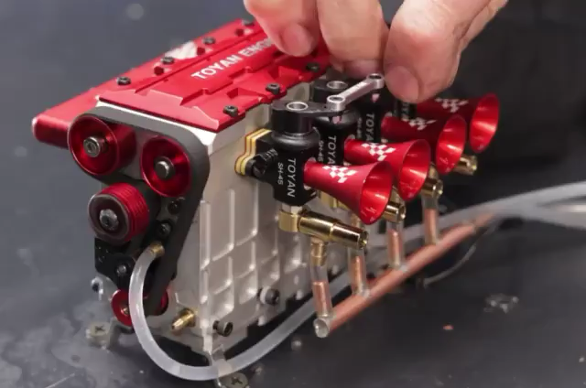
Internal Combustion Engines
2/6
  Working Scaled Model: Multi Cylinder 4 Stroke T, & V shaped engines-Fuel (V2, V4, V8 also available) (Gasoline)
V8
4- Cylinder
Edu-Tek Equipments India Private Limited - 2024 - All Rights Reserved

Slide 32
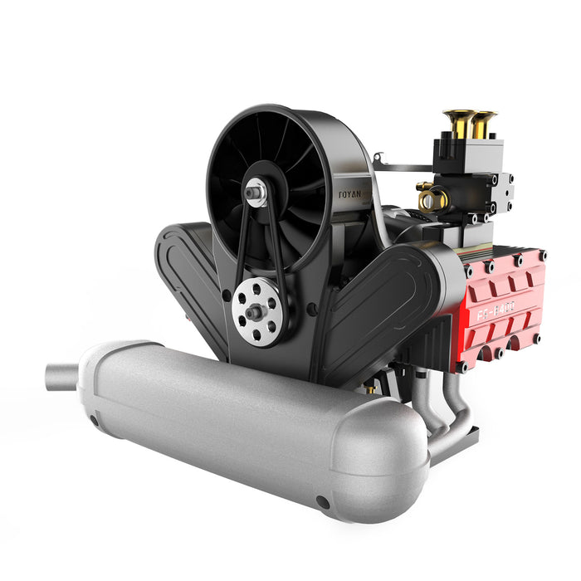
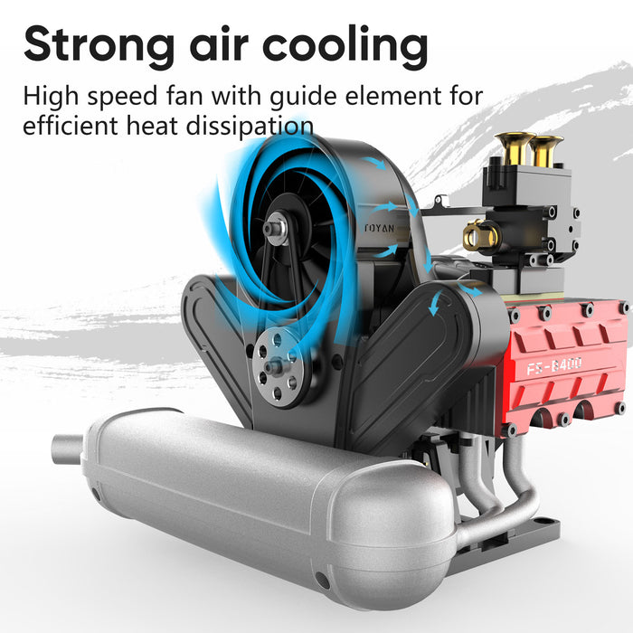
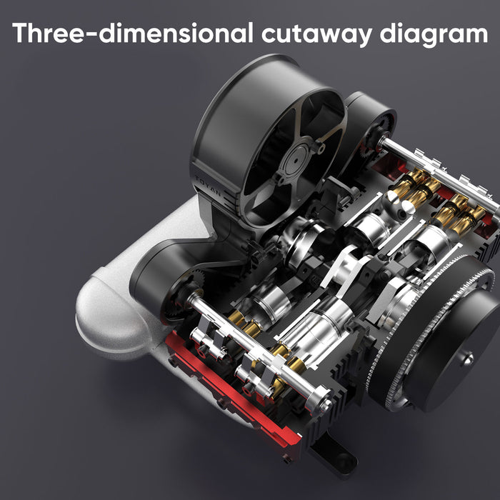
Internal Combustion Engines
3/6
  Working Scaled Model: 14cc Multi Cylinder Four Stroke Flat-four Engine Horizontal Nitro H4
Specifications
Material: Metal
Form: Assembled/KIT Version
Displacement: 4.2(3.5 x 4)CC
Stroke: Horizontally Opposed 4-Stroke
Cylinder Diameter: 16.68mm
Stroke: 15.40mm
Cooling Method: Air-cooled
Lubrication Method: Mixed Oil Splash Lubrication
Start Method: Electric Start
Ignition Method: Ignition Module
Spark Plug Type: Four-stroke F-type Glow Plug
Fuel Type: 20-25% Nitro Fuel
Lubricating Oil Type: Common Grease
Product Weight: 1850g
Package Weight: 2000g
Product Dimensions: 18.4 x 15.2 x 14.1cm
Package Dimensions: 20 x 20 x 20cm
Packing: Box
Fuel Operated
Edu-Tek Equipments India Private Limited - 2024 - All Rights Reserved

Slide 33
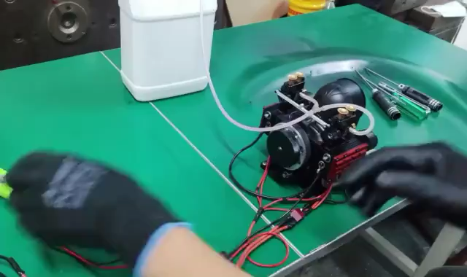
Internal Combustion Engines
4/6
  Working Scaled Model: 14cc Multi Cylinder Four Stroke Flat-four Engine Horizontal Nitro H4
Edu-Tek Equipments India Private Limited - 2024 - All Rights Reserved

Slide 34
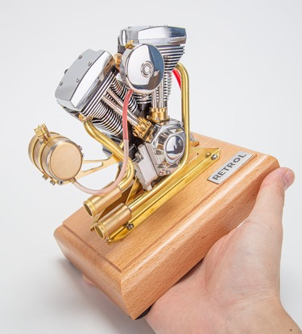

Internal Combustion Engines
5/6
  Working Scaled Model: Multi Cylinder 4 Stroke T, & V shaped engines-Fuel (V2, V4, V8 also available) (Gasoline)
Specifications
Color: Brassiness & Sliver
Material: Brass + Stainless Steel
Type: V-Twin 2-Cylinder 4-Stroke Gasoline Engine
Overall Dimensions: 15 x 12 x 14cm
Engine Dimensions: 12 x 9 x 11.5cm
Wooden Base Dimensions: 15 x 12 x 3cm
Scale: 1/5
Product State: Ready to Run
Displacement: 4.2CC
Cylinder Diameter: 13mm
Stroke: 16mm
Cooling Method: Air-cooled
Starting Method: Electric Drill Start/Manual Start
Ignition Method: CDI Electronic Ignition
Spark Plug Type: 3/16-40-inch Threaded Spark Plug
Lubrication Method: Mixed/Splash Lubrication (Gasoline/Oil=25/1)
Fuel: 95# Gasoline
Oil: 2T Oil
Starting Power Battery: 4.5V AA Battery*3 (Not Included)
Product Weight: 1300g
Product Dimensions: 12 x 9 x 11cm
Fuel Operated
Edu-Tek Equipments India Private Limited - 2024 - All Rights Reserved

Slide 35

Internal Combustion Engines
6/6
  Working Scaled Model: Multi Cylinder 4 Stroke T, & V shaped engines-Fuel (V2, V4, V8 also available) (Gasoline)
Edu-Tek Equipments India Private Limited - 2024 - All Rights Reserved

Slide 36


Internal Combustion Engines
  Working Scaled Model: Multi Cylinder 4 Stroke–Electricity based (Mimicking Diesel)
Specifications
Material: Stainless Steel + Aluminum Alloy
Model: DM115
Coloring Process: Anodic Oxidation
Scale: 1/10
Drive Mode: Motor Driver
External Power: DC 5V (USB Cable)
Battery: 450mAh Li Battery
Charging Time: 2h
Service Time: Over 60mins (At Full Power)
Assembling Time: 4h
Product Dimensions: 18 x 9.2 x 14.5cm
Product Weight: 1500g
Package Dimensions: 20 x 20 x 15cm
Package Weight: 1800g
Electrically Operated
Edu-Tek Equipments India Private Limited - 2024 - All Rights Reserved

Slide 37

Internal Combustion Engines
  Working Scaled Model: Multi Cylinder 4 Stroke–Electricity based (Mimicking Diesel)
Edu-Tek Equipments India Private Limited - 2024 - All Rights Reserved

Slide 38

Internal Combustion Engines
  Working Scaled Model: Rotary ( Wankel Engine) – Non-fuel
Specifications
Material: Metal + ABS
Model: Wankel Rotatory Engine Model
Item No.: RE
Product Dimensions: 15 x 12.5 x 15m
Product Weight: 750g
Package Dimensions: 20 x 18 x 8cm
Package Weight: 950g
Electrically Operated
Edu-Tek Equipments India Private Limited - 2024 - All Rights Reserved

Slide 39

Internal Combustion Engines
  Working Scaled Model: Rotary ( Wankel Engine) – Electrically operated
Edu-Tek Equipments India Private Limited - 2024 - All Rights Reserved

Slide 40
Steam Engines and Turbine
Steam Engine with Boiler
Vertical Steam Engine with Cylindrical Boiler
Vertical Steam engine with Spherical Boiler
Multistage Steam Turbine
Edu-Tek Equipments India Private Limited - 2024 - All Rights Reserved

Slide 41


Steam Engines
  Working Scaled Model: Steam Engine with Boiler
Specifications
Material: Metal
Speed Range: 500-1000rpm
Product Weight: 1800g
Package Weight: 1950g
Product Dimensions: 18 x 18 x 17cm
Package Dimensions: 21 x 21 x 11cm
Fuel Operated
Edu-Tek Equipments India Private Limited - 2024 - All Rights Reserved

Slide 42

Steam Engines
  Working Scaled Model: Steam Engine with Boiler
Edu-Tek Equipments India Private Limited - 2024 - All Rights Reserved

Slide 43


Steam Engines
  Working Scaled Model: Vertical, Cylindrical Steam Engine with Boiler
Specifications
Material: Metal
Item No: K006
Product Dimensions: 16 x 12 x 16cm
Product Weight: 1100g
Package Dimensions: 20 x 20 x 20cm
Package Weight: 1500g
Fuel Operated
Edu-Tek Equipments India Private Limited - 2024 - All Rights Reserved

Slide 44

Steam Engines
  Working Scaled Model: Vertical, Cylindrical Steam Engine with Boiler
Edu-Tek Equipments India Private Limited - 2024 - All Rights Reserved

Slide 45


Steam Engines
  Working Scaled Model: Vertical, Spherical Steam Engine with Boiler
Specifications
Material: Metal
Product Dimensions:20 x 9 x14cm
Product Weight: 700g
Package Dimensions: 25 x 15 x 6.5cm
Package Weight: 900g
Fuel Operated
Edu-Tek Equipments India Private Limited - 2024 - All Rights Reserved

Slide 46

Steam Engines
  Working Scaled Model: Vertical, Spherical Steam Engine with Boiler
Edu-Tek Equipments India Private Limited - 2024 - All Rights Reserved

Slide 47


Steam Engines
  Working Scaled Model: Multistage Steam Turbine
Specifications
Material: Metal + Plexiglass + Plastic
Product Weight: 650g
Package Dimensions: 18*12.5*13cm
Package Weight: 700g
Fuel Operated, Comes without Boiler, Also Available in Single stage mode
Edu-Tek Equipments India Private Limited - 2024 - All Rights Reserved

Slide 48
Others
V8 Solenoid based engine
Oil Rig
Stirling Engines
Car Gear Mechanism Model
Hydraulic Press Lab Model
Edu-Tek Equipments India Private Limited - 2024 - All Rights Reserved

Slide 49


Others
  Working Model: V8 Solenoid based engine
Specifications
Item Name: Electromagnetic Engine Model
Material: Acrylic + Copper + Stainless Steel
Size: 28 x 10.8 x 11cm
Weight: 920g
Packing: Carton Box
Also available in V2, V4, V6 AND V12 Variants
Electrically Operated
Edu-Tek Equipments India Private Limited - 2024 - All Rights Reserved

Slide 50

Others
  Working Model: V8 Solenoid based engine
Edu-Tek Equipments India Private Limited - 2024 - All Rights Reserved

Slide 51


Others
  Working Model : Oil Rig
Specifications
Product Name: Pumping Unit Model Kit
Material: Aluminium Alloy + Stainless Steel
Finished Size: 247 x 54 x 227mm
Charging Voltage: DC5V
Battery Capacity: 500mAh
Product Dimensions: 24.7 x 5.4 x 22.7cm
Product Weight: 636g
Package Dimensions: 26.2 x 5.1 x 21.5cm
Package Weight: 1207g
Fuel Operated
Edu-Tek Equipments India Private Limited - 2024 - All Rights Reserved

Slide 52

Others
  Working Model : Oil Rig
Edu-Tek Equipments India Private Limited - 2024 - All Rights Reserved

Slide 53





Others
  Working Model: Wide Variety of Stirling Engine
Specifications
Material: Metal + Wood + Quartz Glass
Product Dimensions: 10 x 10 x 6cm
Product Weight: 370g
Package Dimensions: 12 x 12 x 10cm
Package Weight: 470g
Packing: Box
Fuel Operated
Note: We have more than 50 models of Stirling Engines and can send more detailed information about the dimensions, specifications and other details on special requests. This slide just shows a few products.
Edu-Tek Equipments India Private Limited - 2024 - All Rights Reserved

Slide 54

Others
  Working Model: Wide Variety of Stirling Engine
Edu-Tek Equipments India Private Limited - 2024 - All Rights Reserved

Slide 55


Others
  Car Manual Transmission 5 Forward Gears plus R Reverse Gear with Clutch Differential
Specifications
Material: Plastic + Metal + Electronic Components
Product Weight: 415g
Package Dimensions: 15 x 15 x 15cm
Package Weight: 850g
Packing: Graphic Carton
Edu-Tek Equipments India Private Limited - 2024 - All Rights Reserved

Slide 56


Others
  Hydraulic Press Lab Model
Specifications
Item Name: Hydraulic Press Machine
Material: Metal
Small Piston Size: 1.4cm, Area: 1.54cm
Large Piston Size: 4.8cm, Area: 18cm
Normal pressure: 2—2.2Mpa
Product Dimensions: 25 x 14 x 29cm
Product Weight: 4500g
Package Weight: 5500g
Edu-Tek Equipments India Private Limited - 2024 - All Rights Reserved

Slide 57
List of other available engines and products
1 | Aeroplane Engine | Radial Engine
2 | Aeroplane Engine | Turbofan Engine
3 | Aeroplane Engine | Gasoline Powered Jet engine
4 | V8 Engine | V8 Engine model kit
5 | V8 Engine | Gasoline based water cooled
6 | V8 Engine | Electromagnetic V8 engine
7 | Steam Engine | Steam engine with boiler
8 | Steam Engine | Mini Steam Engine Full Metal
9 | Steam Engine | Steam Engine Experiment Model
10 | Steam Engine | Mini Steam Engine Full Metal
11 | Steam Engine | Steam engine producing electricity and rotational motion
12 | Steam Engine | Mini Steam Boiler Steam Engine
13 | Steam Engine | Mini V4-Steam Engine Miniature Steam Engine -No boiler
14 | Steam Engine | Opposed 4-Cylinder Steam Engine Model With Gearbox- No Boiler
15 | Steam Engine (Accessory) | Mini Steam Engine Flyball Speed Governor
16 | Steam Engine | Metal Steam Turbine Engine Model -No boiler
17 | Steam Engine | Steam Engine 3-cylinder -no boiler
18 | Steam Engine | Mini Steam Engine with Steam Boiler
19 | Steam Engine | Single Stage Steam Turbine
Edu-Tek Equipments India Private Limited - 2024 - All Rights Reserved

Slide 58
List of other available engines and products
20 | IC Engine | 4.2CC Mini V2 Engine OHV V-Twin Motorcycle Engine Double-cylinder Four-stroke
21 | IC Engine | 4-Stroke Hot-bulb Engine Simulation Horizontal Water-cooled Gasoline Tractor Engine
22 | IC Engine | M12 1.6cc Mini 4 Stroke Retro Water-cooled Gasoline Gas Engine
23 | IC Engine | Vertical 4-cylinder OHV Gas Engine Internal Combustion Engine Tractor Engine Model with Mechanical Speed Limit Complete Water Circulation Cooling System
24 | IC Engine | 1.9CC Horizontal Single Cylinder Four-stroke Engine Internal Combustion Engine Model for Three-Wheelers
25 | IC Engine | 1.6cc Mini 4 Stroke Gasoline Engine Model Vertical Air-cooled Single-cylinder
26 | IC Engine | M14 1.9cc Mini 4 Stroke Gas Engine Internal Combustion Engine Model Atkinson Differential Opposed Piston
27 | IC Engine | 3.5cc Mini Evaporative Cooled Single-cylinder 4-stroke Gasoline Engine Internal Combustion Engine Model 8000rpm
28 | IC Engine | L6-210 Engine 1/8 Scale 21cc Mini Inline 6 Cylinder 4 Stroke Water-cooled L6 Gasoline Engine
29 | IC Engine | V2 Engine 4.2CC OHV V-Twin Four-Stroke Gasoline Engine Mini Retro Motorcycle Engine Model with Pedal Start
30 | IC Engine | Small-block 44CC 1/6 Scale Water-Cooled OHV 4-Stroke V8 Gas Engine Internal Combustion Engine
31 | IC Engine | 78CC DOHC Four-Stroke V-Shaped Eight-Cylinder Water-cooled Electric Gasoline Internal Combustion Engine Model - V8 Engine Model That Works
32 | IC Engine | 4 CYLENDER DIESEL ENGINE
33 | IC Engine | Flat Twin Airhead Engine Model Kit (Transparent +Plastic)
34 | IC Engine | 4 Cylinder Car Engine
35 | E-Motors | Metal Six-cylinder Brushless Electromagnetic Engine Model
36 | E-Motors | Metal V12 Brushless Electromagnetic Engine Model
37 | E-Motors | Metal Mini V Type Double-cylinder V2 Electromagnetic Engine Model
Edu-Tek Equipments India Private Limited - 2024 - All Rights Reserved

Slide 59
List of other available engines and products
38 | E-Motors | Metal Mini Type Single-cylinder Electromagnetic Engine Cannon Model
39 | E-Motors | V6 Electromagnetic Motor Engine Model with Hexagon Fans
40 | E-Motors | Metal V6 Double-piston Brushless Electromagnetic Engine
41 | E-Motors | V8 Electromagnetic Engine 5V 4W 8 Coils High Speed V-Shaped
42 | H&M Engine | Horizontal Air-Cooled Single-Cylinder 4-Stroke Oddball Hit and Miss Gas Engine
43 | H&M Engine | Hit and Miss Engine Full Metal IC Engine
44 | H&M Engine | M91 Vertical Hit and Miss Engine
45 | Antique Engine | Horizontal Single Cylinder Four-stroke Engine Internal Combustion Engine Model for Three-Wheelers
46 | Antique Engine | 3.2cc Mini Gasoline Engine 2-Cylinder 4-Stroke Motorcycle Internal Combustion Engine ICE Engine Model
47 | Antique Engine | Engine FV1A KW-OHV 7cc Vertical Single Cylinder 4 Stroke Air Cooled Gasoline Engine
48 | V2 Engine | Actual working models with variations in size or brand
49 | V2 Engine | Plastic Model that shows internal working
50 | V12 Engine | V12 Engine GS-V12 72CC DOHC 4-Stroke 12-Cylinder 48-Valve Water-Cooled Electric Start Gasoline Engine Model - V12 Engine
51 | Stirling Engine | A wide variety of Stirling engine
52 | Oil Pumping | Pumping unit
Edu-Tek Equipments India Private Limited - 2024 - All Rights Reserved

Slide 60
Sales and Contact information
For all Sales inquiries contact :
Edu-Tek Equipment India Pvt. Ltd.
162 Vigyan Vihar, Delhi, 110092
Mobile: +91 9810106994, +91 7217777926
Email: edutek@gmail.com
Website: Edutek.in
A more comprehensive list of products and detailed product working videos with explanation can be provided on special requests.
Edu-Tek Equipments India Private Limited - 2024 - All Rights Reserved

